Slide 1
Programming Fundamentals

Slide 2
Objectives
At the end of the lesson, the student should be able to:
Identify the basic parts of a Java program
Differentiate among Java literals, primitive data types, variable types ,identifiers and operators
Develop a simple valid Java program using the concepts learned in this chapter
●
●
●

Slide 3
Dissecting my First Java Program
1 public class Hello 2 {
3 /**
4 * My first Java program 5 */
6 public static void main( String[] args ){ 7
8
9
10
//prints the string Hello world on screen System.out.println(“Hello world”);
11
12 }
}

Slide 4
Coding Guidelines
Your Java programs should always end with the .java
extension.
Filenames should match the name of your public class. So for example, if the name of your public class is Hello, you should save it in a file called Hello.java.
You should write comments in your code explaining what a certain class does, or what a certain method does.

Slide 5
Java Comments
●
Comments
These are notes written to a code for documentation purposes.
Those texts are not part of the program and does not affect the flow of the program.
–
–

Slide 6
Java Identifiers
●
Identifiers
are tokens that represent names of variables, methods, classes, etc. Examples of identifiers are: Hello, main, System, out.
–
–
Java identifiers are case-sensitive.
– This means that the identifier Hello is not the same as hello.
●

Slide 7
Java Identifiers
●
Identifiers must begin with either a letter, an underscore “_”, or a dollar sign “$”. Letters may be lower or upper case.
Subsequent characters may use numbers 0 to 9.
●
Identifiers cannot use Java keywords like class, public, void, etc. We will discuss more about Java keywords later.

Slide 8
Java Identifiers Coding Guidelines
For names of classes, capitalize the first letter of the class name. For example,
ThisIsAnExampleOfClassName
For names of methods and variables, the first letter of the word should start with a small letter. For example,
thisIsAnExampleOfMethodName

Slide 9
Java Identifiers Coding Guidelines
In case of multi-word identifiers, use capital letters to indicate the start of the word except the first word. For example,
charArray, fileNumber, ClassName.
Avoid using underscores at the start of the identifier such as _read or _write.

Slide 10
Java Keywords
●
Keywords are predefined identifiers reserved by Java for a specific purpose.
You cannot use keywords as names for your variables, classes, methods ... etc.
The next slide contains the list of the Java Keywords.
●
●

Slide 11
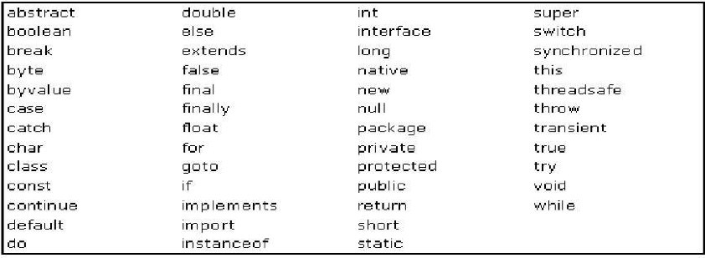
Java Keywords

Slide 12
Java Literals
Literals are tokens that do not change - they are constant. The different types of literals in Java are:
●
●
Integer Literals Floating-Point Literals Boolean Literals Character Literals String Literals
–
–
–
–
–

Slide 13
Primitive Data Types
●
The Java programming language defines eight primitive data types.
boolean (for logical) char (for textual) byte
short int
long (integral) double
float (floating point).
–
–
–
–
–
–
–
–

Slide 14
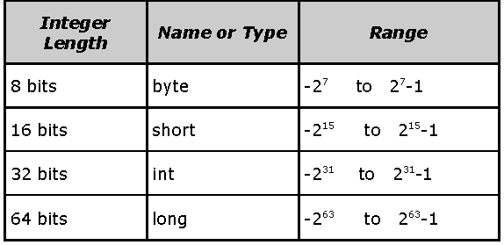
Primitive Data Types: Integral
– byte, short, int & long
●
Integral data type have the following ranges:

Slide 15
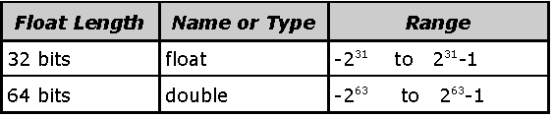
Primitive Data Types: Floating Point – float and
double
●
Floating-point data types have the following ranges:

Slide 16
Variables
●
A variable is an item of data used to store the state of objects.
A variable has a:
– data type
●
●
The data type indicates the type of value that the variable can hold.
–
name
●
The variable name must follow rules for identifiers.

Slide 17
Declaring and Initializing Variables
Declare a variable as follows:
<data type> <name> [=initial value];
●
●
Note: Values enclosed in <> are required values, while those values in [] are optional.

Slide 18
System.out.println() vs.
System.out.print()
System.out.println()
Appends a newline at the end of the data output
System.out.print()
Does not append newline at the end of the data output
●
●

Slide 19
Operators
●
Different types of operators:
arithmetic operators relational operators logical operators conditional operators
–
–
–
–
●
These operators follow a certain kind of precedence so that the compiler will know which operator to evaluate first in case multiple operators are used in one statement.

Slide 20
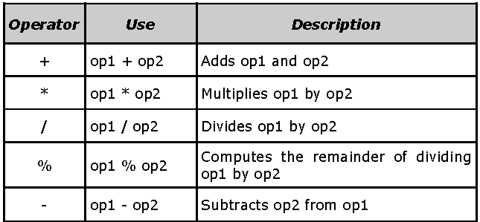
Arithmetic Operators

Slide 21
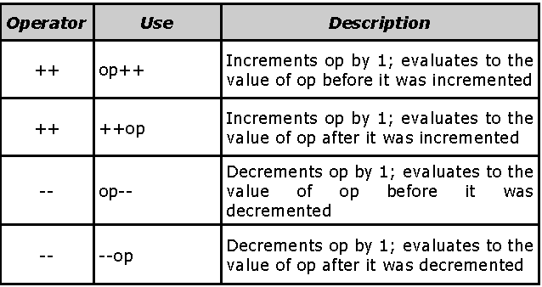
Increment and Decrement Operators

Slide 22
Logical Operators
●
Logical operators have one or two boolean operands that yield a boolean result.
There are six logical operators:
●
&& (logical AND)
& (boolean logical AND)
|| (logical OR)
| (boolean logical inclusive OR)
^ (boolean logical exclusive OR)
! (logical NOT)
–
–
–
–
–
–

Slide 23
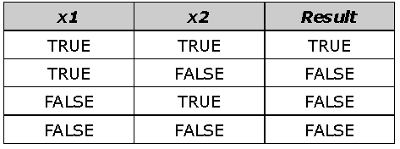
Logical Operators: &&(logical) and &(boolean logical) AND
●
Here is the truth table for && and &,

Slide 24
Summary
●
Java Comments (C++-Style Comments, C-Style Comments, Special Javadoc Comments)
Java statements, blocks, identifiers, keywords
Java Literals (integer, floating point, boolean, character, String)
Primitive data types( boolean, char, byte, short, int, long, float, double)
●
●
●

Slide 25
Summary
Variables (declare, initialize, output) System.out.println() vs. System.out.print() Reference Variables vs. Primitive Variables
Operators (Arithmetic operators, Increment and Decrement operators, Relational operators, Logical operators, Conditional Operator (?:), Operator Precedence)
●
●
●
●

